Slide 1
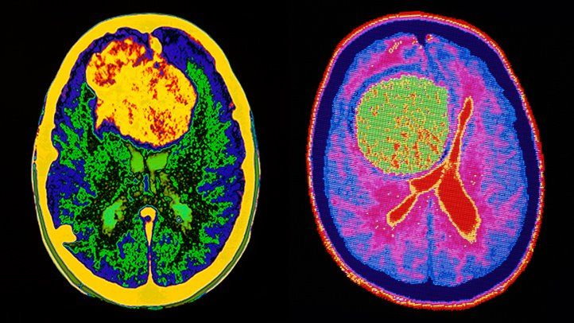
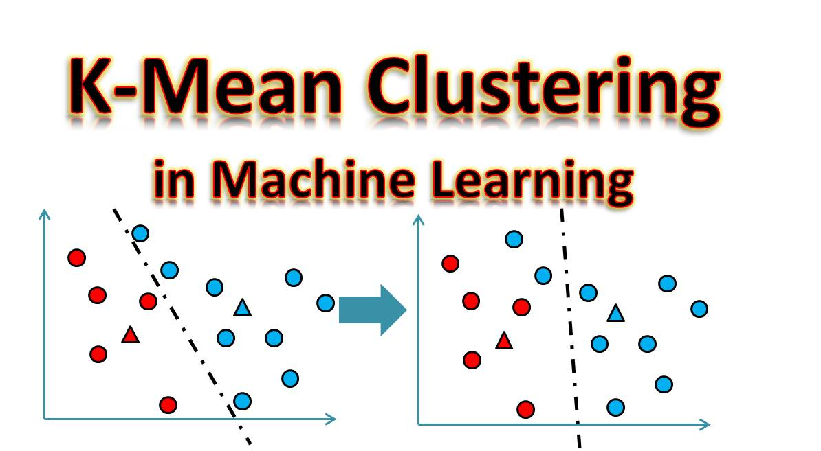
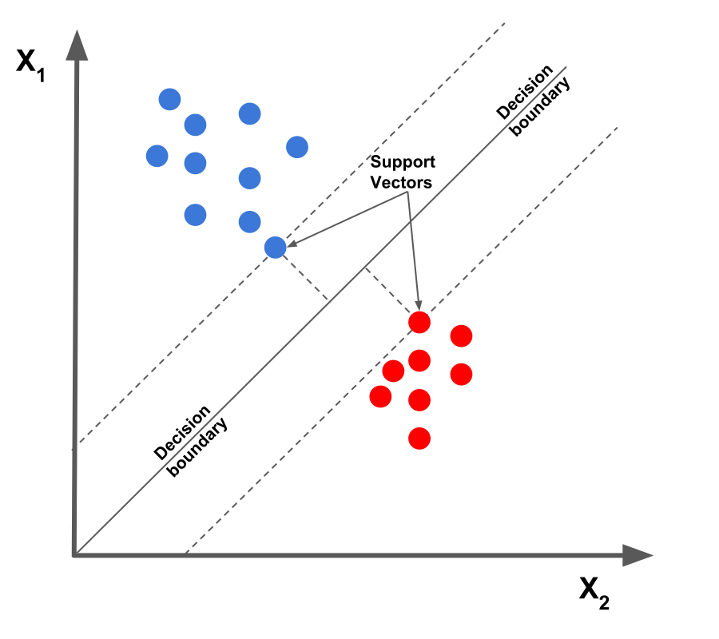
Detection of Brain Tumor Using Image Processing
By-
Azim damani a
20bd1a1273

Slide 2
INTRODUCTION
Brain tumor is an accumulation of anomalous tissue in the brain. Tumors are primarily classified into malignant and benign when they develop.
Brain tumors are frequently referred to as cancerous also termed as malignant or noncancerous termed as benign.
The benign tumors are not as aggressive as malignant tumors i.e. the mass or development of unusual cells does not contain cancer cells.
This paper proposes a system to decide whether the brain has tumor or is it tumor-free from the MR image using combined technique of K-Means and support vector machine.

Slide 3
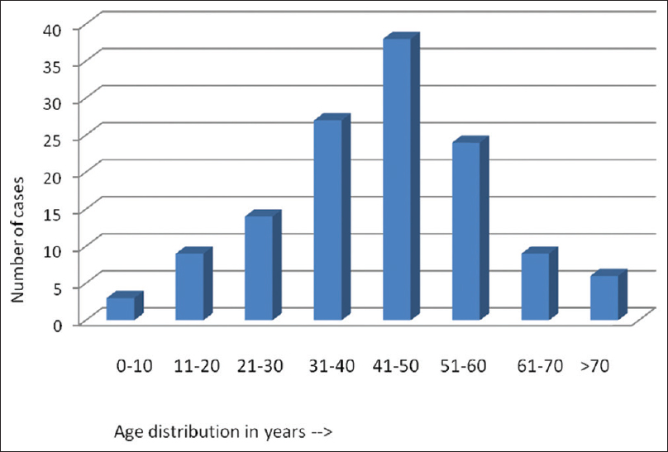
INDIAN Data and statistics
The incidence of central nervous system (CNS) tumors in India ranges from 5 to 10 per 100,000 population with an increasing trend and accounts for 2% of malignancies.
Hospital‑based databases capturing CNS malignancies had been analyzed prospectively from registrations in the neuro‑oncology clinic of a tertiary care center over a period of 1 year.
Astrocytoma (38.7%) were the most common primary tumors with the majority being high‑grade gliomas (59.5%).
Another multi institutional effort involving seven tertiary care hospitals reported the epidemiological profile of 3936 pediatric tumor patients. The most common tumor was astrocytoma (34.7%) followed by medulloblastoma(MB) and supratentorial PNETs (22.4%) and craniopharyngioma.
https://www.researchgate.net/publication/305792229_Indian_data_on_central_nervous_tumors_A_summary_of_published_work

Slide 4
software / technology requirements
Combination of K-Means clustering algorithm, Fuzzy C – means(FCM).
Thresholding and Morphological operations in detecting brain tumors
Support Vector Machine Algorithm.

Slide 5
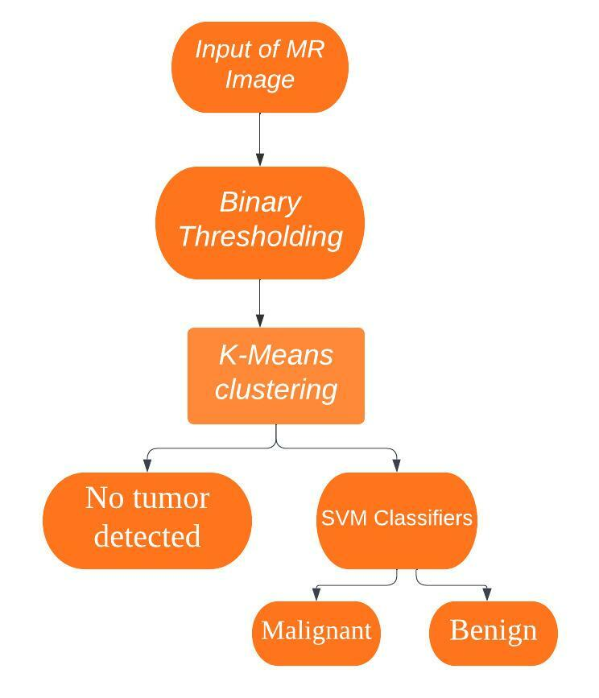
PROPOSED ARCHITECURE
Algorithm:
Input: MR Image selected by user.
Output: Report generated after the detected tumor is classified.
Step 1: The selected MR Image is pre-processed using Binary Thresholding.
Step 2: The pre-processed image is then subjected to K-Means clustering and fuzzy c- means.
Step 3: If tumor is not detected the user is notified that there is no tumor present, else if the tumor is detected then further classification of tumor is done using SVM Classifier.
Step 4: After classification is done then report is generated and is displayed to the user.

Slide 6
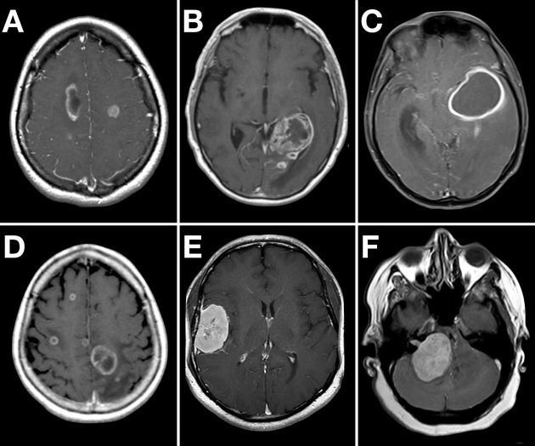
tumor assessment Methods
What is CT scan?
A computerized images taken from different angles around your body and uses computer processing to create cross-sectional images (slices) of the bones, blood vessels and soft tissues inside your body. CT scan images provide more-detailed information than plain X-rays do .
3-dimensional image that shows any abnormalities or tumors. A CT scan can help find bleeding and enlargement of the fluid-filled spaces in the brain, called ventricles.
Changes to bone in the skull can also be seen on a CT scan, and it can be used to measure a tumor’s size. A CT scan may also be used if the patient cannot have an MRI, such as if the person has a pacemaker for their heart.

Slide 7
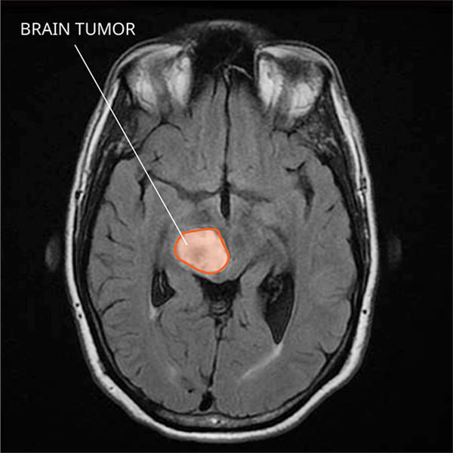
tumor assessment Methods
Magnetic resonance imaging (MRI). An MRI uses magnetic fields, not x-rays, to produce detailed images of the body.
MRI can be used to measure the tumor’s size. A special dye called a contrast medium is given before the scan to create a clearer picture. This dye can be injected into a patient’s vein or given as a pill or liquid to swallow.
MRIs create more detailed pictures than CT scans and are the preferred way to diagnose a brain tumor. The MRI may be of the brain, spinal cord, or both, depending on the type of tumor suspected and the likelihood that it will spread in the CNS. There are different types of MRI. The results of a neuro-examination, done by the internist or neurologist, helps determine which type of MRI to use.
MRI Datasets:http://nist.mni.mcgill.ca/?page_id=672.

Slide 8
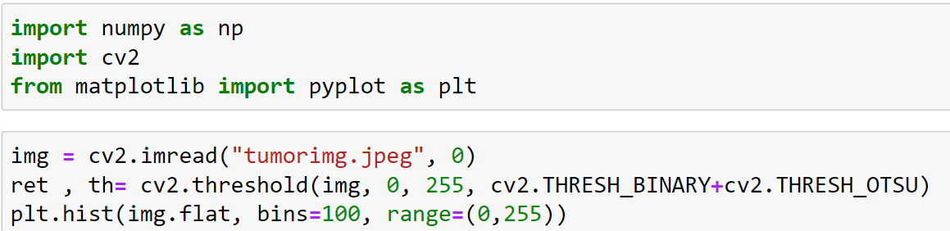
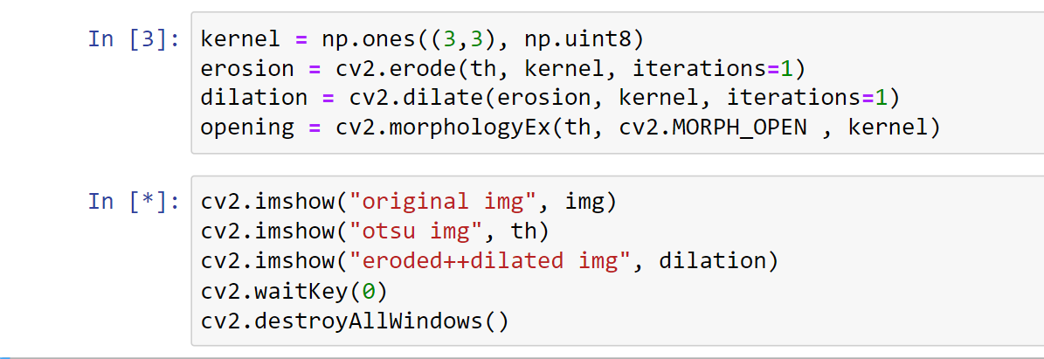
Binary Thresholding
Binary thresholding : We use Binary thresholding improve the quality of the MR image. The value of each pixel will be in the range 0 to 255, here we are using threshold value calculated using[6]. The pixel value below this threshold will be changed to black, and above will be changed to white.

Slide 9
threshold with morphological operations
The most basic morphological operations are dilation and erosion.
Dilation adds pixels to the boundaries of objects in an image.
while erosion removes pixels on object boundaries
The number of pixels added or removed from the objects in an image depends on the size and shape of the structuring element used to process the image.

Slide 10
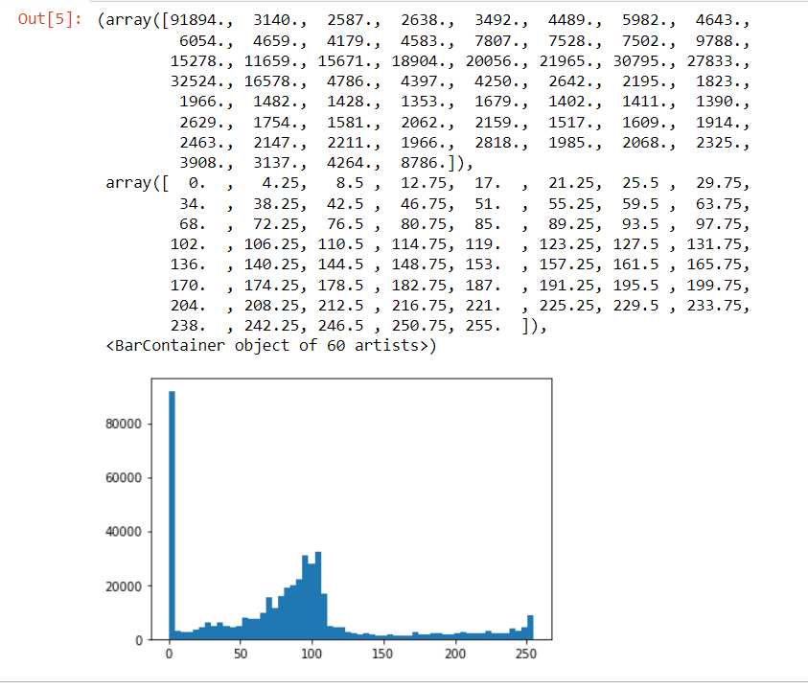
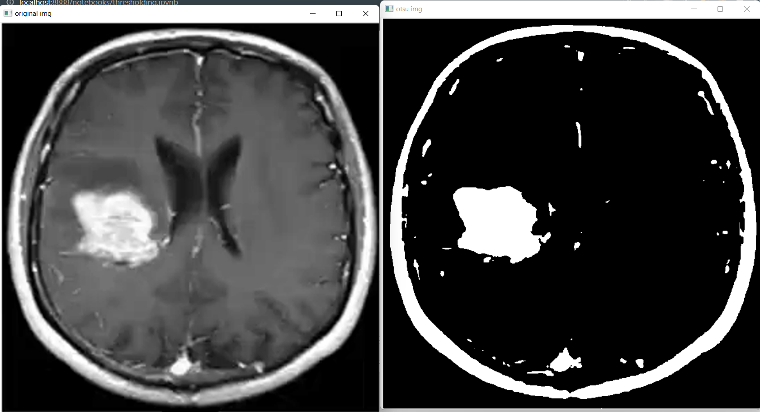
Result of binary thresholding the Mri

Slide 11
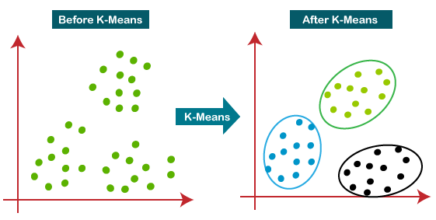
K-Means algorithm
What is K-Means Algorithm?
K-Means Clustering is an Unsupervised Learning algorithm, which groups the unlabeled dataset into different clusters. Here K defines the number of pre-defined clusters that need to be created in the process, as if K=2, there will be two clusters, and for K=3, there will be three clusters, and so on.

Slide 12
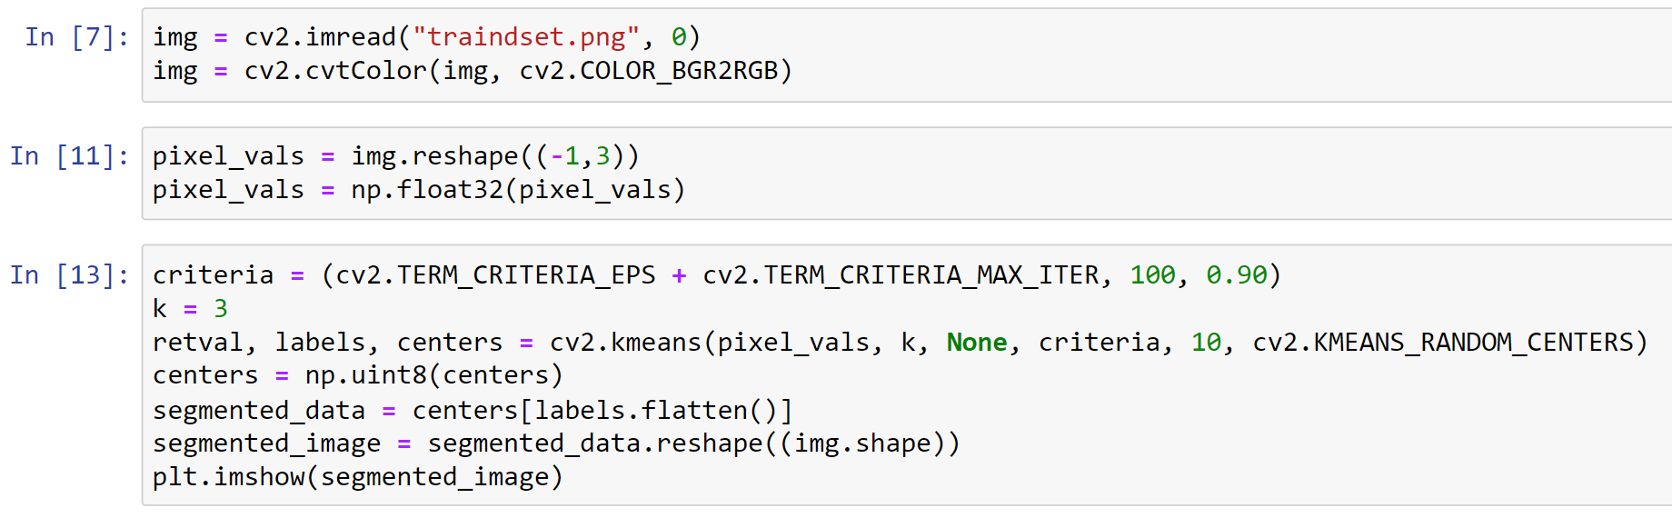
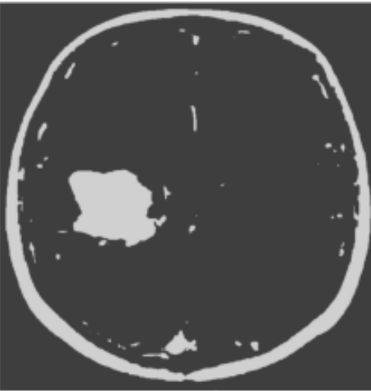
Code for k-means

Slide 13
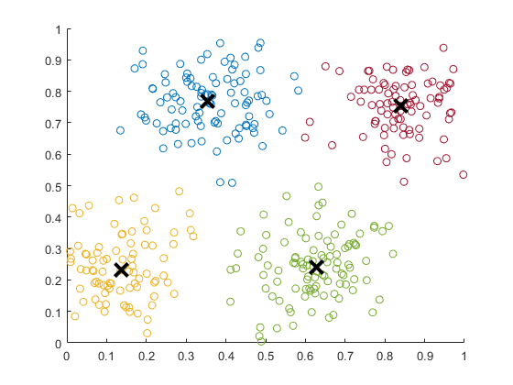
Fuzzy c-means
Fuzzy c-means (FCM) is a data clustering technique in which a data set is grouped into N clusters with every data point in the dataset belonging to every cluster to a certain degree.
What is the difference between k-means clustering and fuzzy C-means clustering?
K means clustering cluster the entire dataset into K number of cluster where a data should belong to only one cluster. Fuzzy c-means create k numbers of clusters and then assign each data to each cluster, but their will be a factor which will define how strongly the data belongs to that cluster.

Slide 14
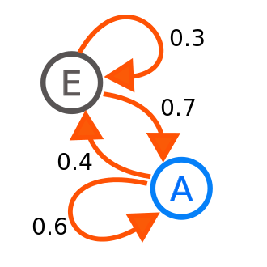
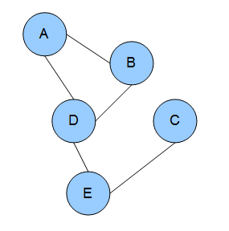
Hidden Markov Random Field Model
A hidden Markov random field is a generalization of a hidden Markov model. Instead of having an underlying Markov chain, hidden Markov random fields have an underlying Markov random field.
Markov chain
Markov random field

Slide 15
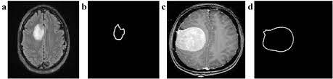
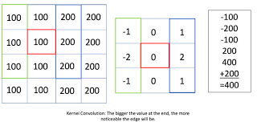
BORDER DETERMINATION OF THE TUMOR AREA using : sobel edge detection
To get the border of the tumor region we have considered a sobel edge filter.
The sobel filter determines edges of image by finding derivative of images. It just finds gradients in the direction of x and y. These Masks are mainly used to operate in vertical and horizontal direction which are further related to pixels in the image.

Slide 16
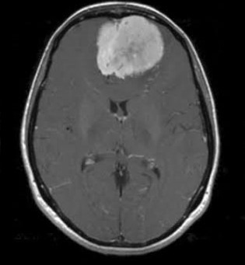
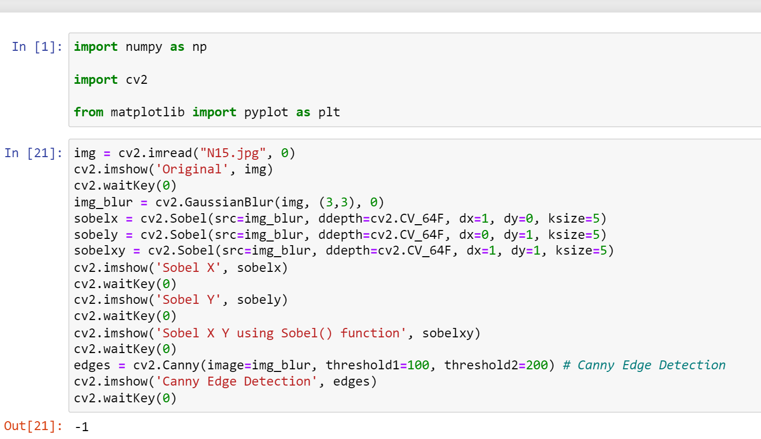
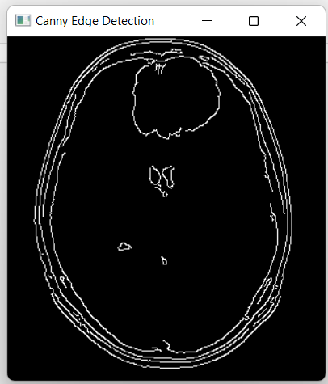
Sobel edge & canny edge detection code

Slide 17
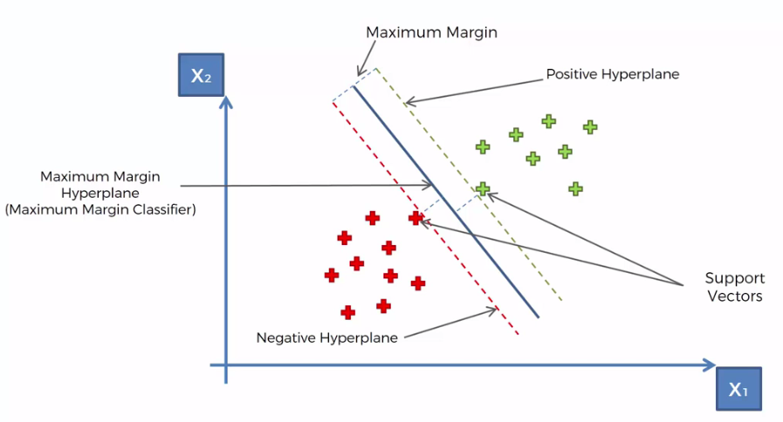
Support vector machine algorithm
Support Vector Machine or SVM is one of the most popular Supervised Learning algorithms, which is used for Classification as well as Regression problems.
The goal of the SVM algorithm is to create the best line or decision boundary that can segregate n-dimensional space into classes so that we can easily put the new data point in the correct category in the future. This best decision boundary is called a hyperplane.
Hyperplane: There can be multiple lines/decision boundaries to segregate the classes in n-dimensional space, but we need to find out the best decision boundary that helps to classify the data points. This best boundary is known as the hyperplane of SVM.

Slide 18
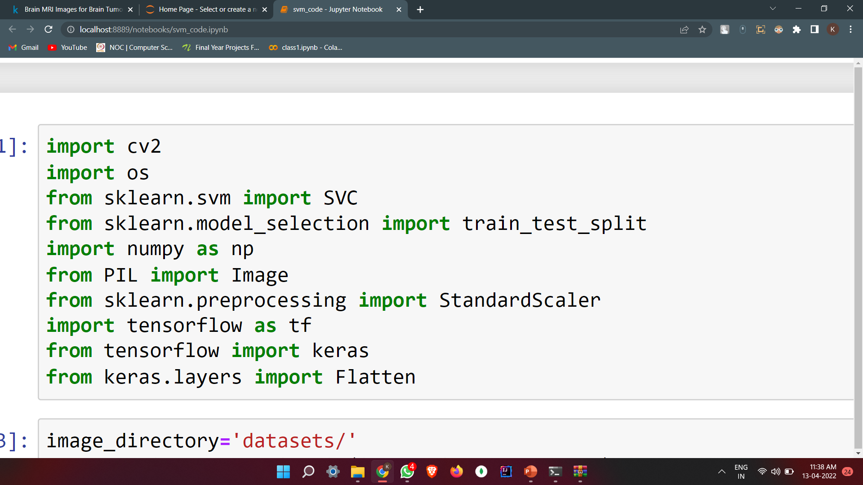
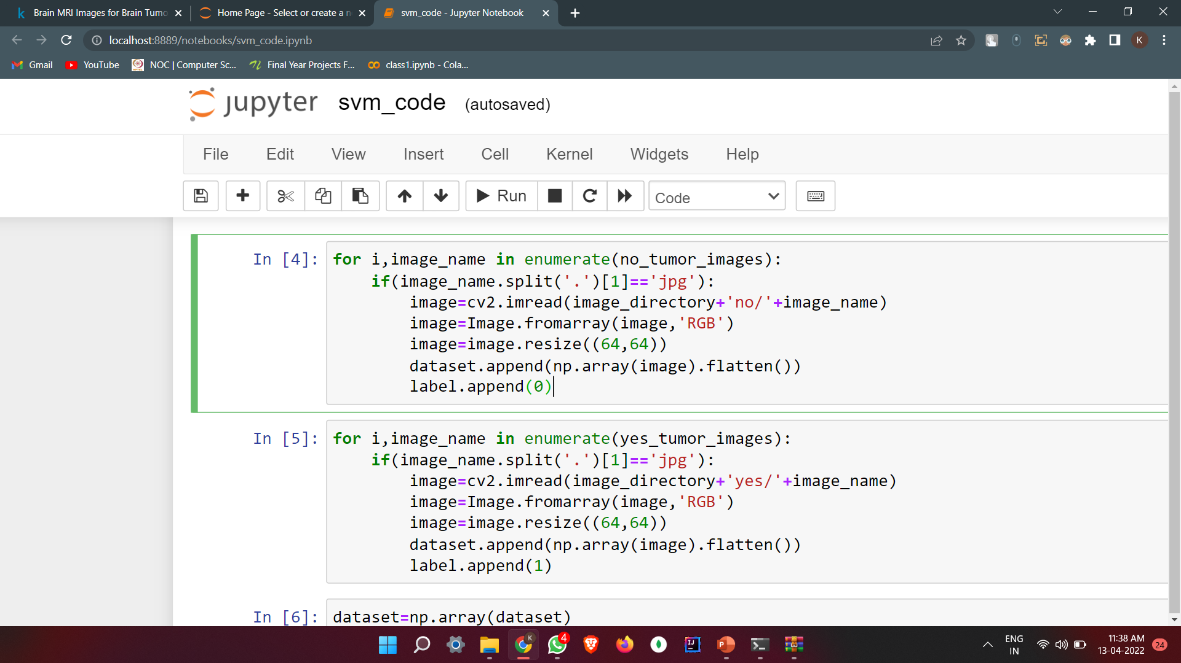
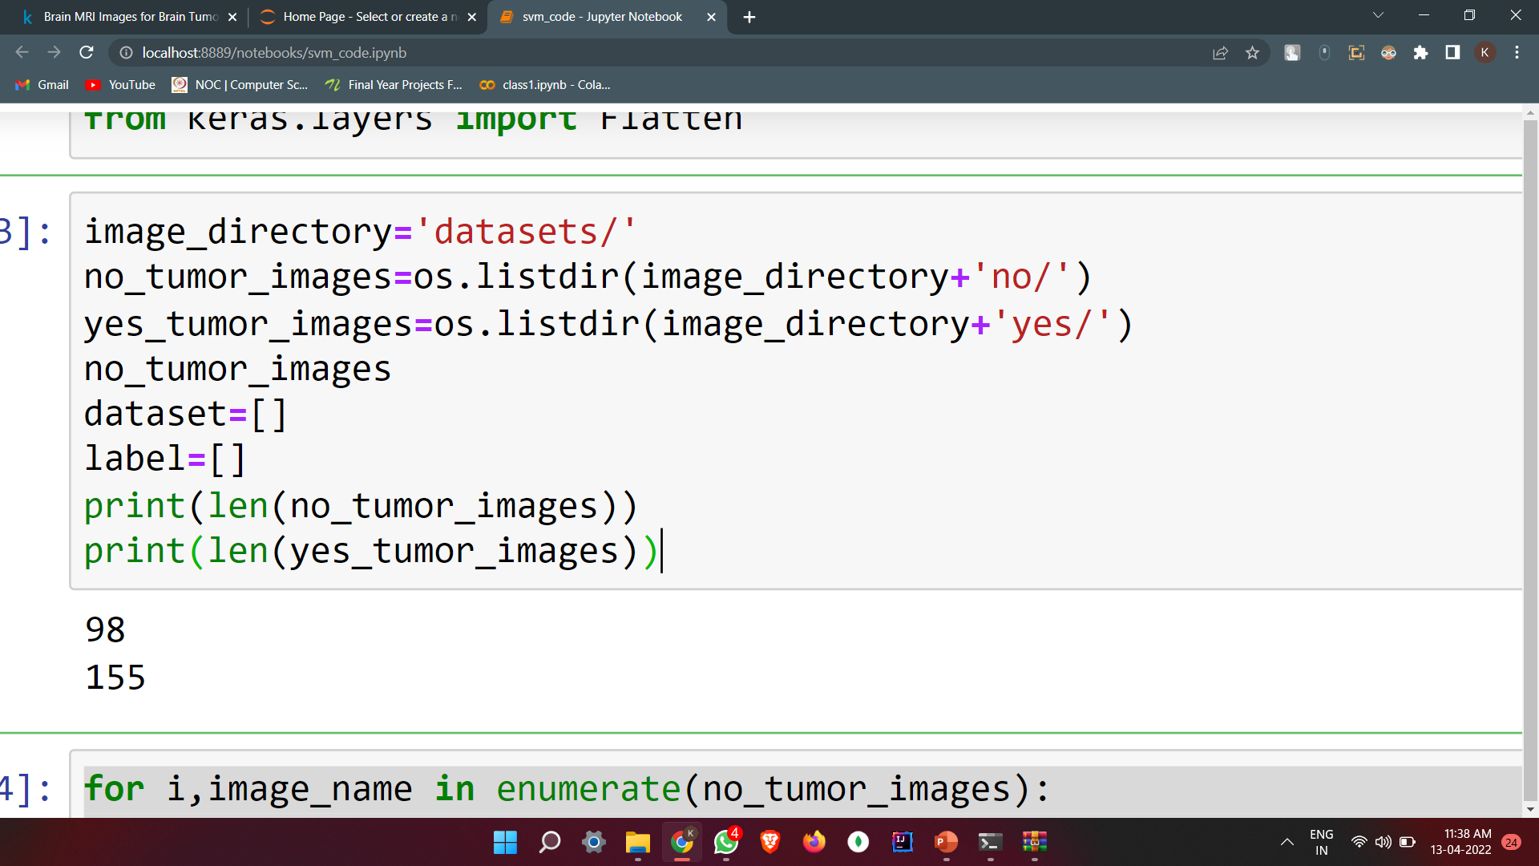
Svm code

Slide 19
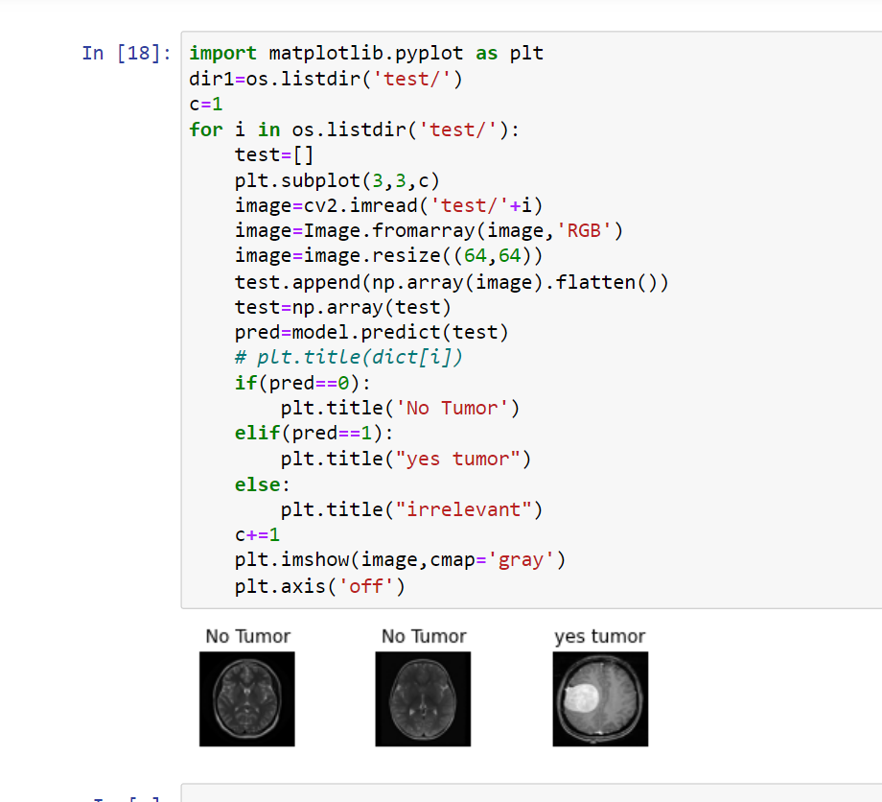
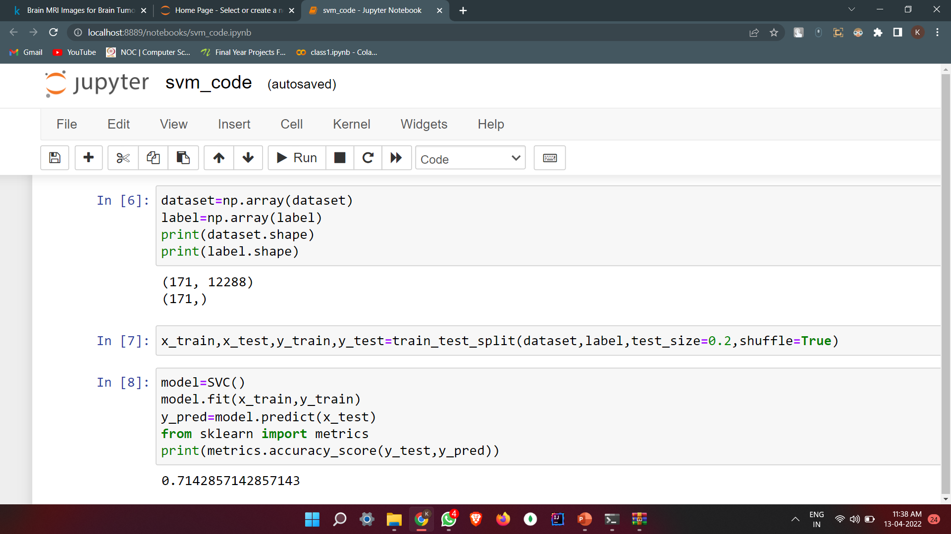
Svm code

Slide 20
Reference papers
Base paper:
https://ieeexplore.ieee.org/document/9076542
Data sets of MRI :
“BITE: Brain Images of Tumors for Evaluation database – NIST.” [Online]. Available: http://nist.mni.mcgill.ca/?page_id=672.
Tumor assessment Methods :
Kimia Rezaei and Hamed Agahi,"Segmentation and Classification of Brain Tumor CT Images Using SVM with Weighted Kernel Width", David C. Wyld et al. (Eds): ITCS, SIP, CST, ARIA, NLP – 2017, pp. 39– 50, 2017. DOI: 10.5121/csit.2017.70304
Reema Mathew A, Babu Anto P, "Tumor Detection and Classification of MRI Brain Image using Wavelet Transform and SVM", Proc. International Conference on Signal Processing and Communication (ICSPC’17) – 28th & 29th July 2017, IEEE, pp. 75 - 78.
Fuzzy c-means and SVM:
Parveen, & Singh, Amritpal. (2015). Detection of brain tumor in MRI images, using combination of fuzzy c-means and SVM. 98- 102. 10.1109/SPIN.2015.7095308.
Threshold with Morphological operations:
Hunnur, Shrutika Santosh et al. “Implementation of image processing for detection of brain tumors.” 2017 International Conference on Intelligent Computing and Control Systems (ICICCS) (2017): 278-283.
Hidden Markov Random Field Model:
H. S. Abdulbaqi, Mohd Zubir Mat, A. F. Omar, I. S. B. Mustafa and L. K. Abood, "Detecting brain tumor in Magnetic Resonance Images using Hidden Markov Random Fields and Threshold techniques," 2014 IEEE Student Conference on Research and Development, Batu Ferringhi, 2014, pp. 1-5
BORDER DETERMINATION OF THE TUMOR AREA:
Manisha, B. Radhakrishnan and L. P. Suresh, "Tumor region extraction using edge detection method in brain MRI images," 2017 International Conference on Circuit, Power and Computing Technologies (ICCPCT), Kollam, 2017, pp. 1-5.

